Slide 1
Chapter # 09 Relations
9.1 Relations and Their Properties
What is Function & Difference between
Function and Relation
A relation shows the relationship between input and output, and a function is a relation which derives one OUTPUT for each given INPUT.
A = {1, 2} and B = {3, 4, 5}, then the
Cartesian Product of
A * B = {(1, 3), (1, 4), (1, 5), (2, 3), (2, 4), (2, 5)}.
FREE: For Complete Playlist: https://www.youtube.com/c/FahadHussaintutorial/playlists
For Code, Slide and Books: https://fahadhussaincs.blogspot.com/

Slide 2
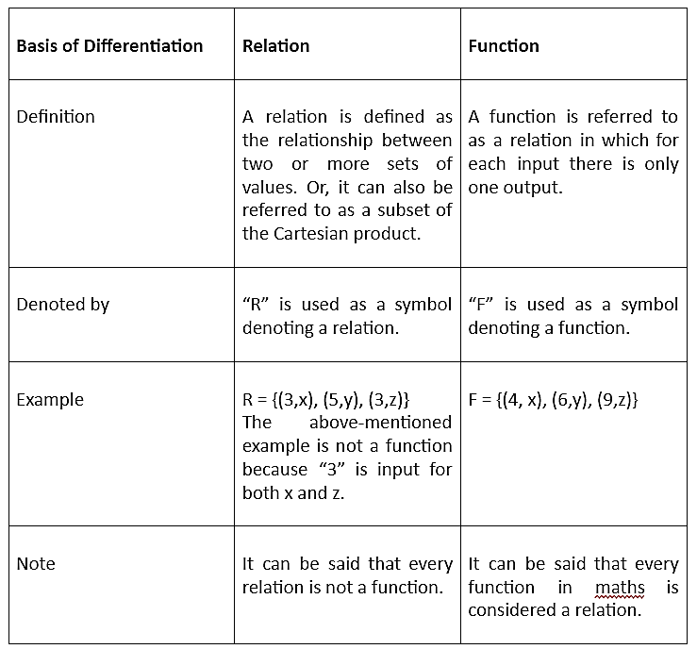

Slide 3

Binary Relations
Definition: A binary relation R from a set A to a set B is a subset
R ⊆ A × B.
Recall, for example:
A = {a1, a2} and B = {b1, b2, b3}
A x B = { (a1, b1), (a1, b2), (a1, b3),
(a2, b1), (a2, b2), (a2, b3)}
Ordered pairs, which
First element comes from A
Second element comes from B
aRb: (a, b) ∈ R
: (a, b) ∉ R
Moreover, when (a, b) belongs to R, a is said to be related to b by R.
FREE: For Complete Playlist: https://www.youtube.com/c/FahadHussaintutorial/playlists
For Code, Slide and Books: https://fahadhussaincs.blogspot.com/

Slide 4
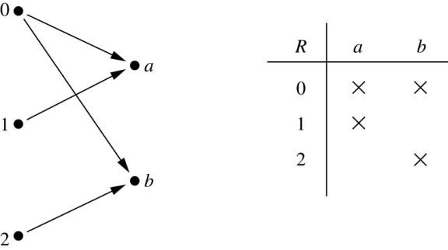
Binary Relations
Example:
Let A = {0,1,2} and B = {a,b}
{(0, a), (0, b), (1,a) , (2, b)} is a relation from A to B.
We can represent relations from a set A to a set B graphically or using a table:
FREE: For Complete Playlist: https://www.youtube.com/c/FahadHussaintutorial/playlists
For Code, Slide and Books: https://fahadhussaincs.blogspot.com/

Slide 5
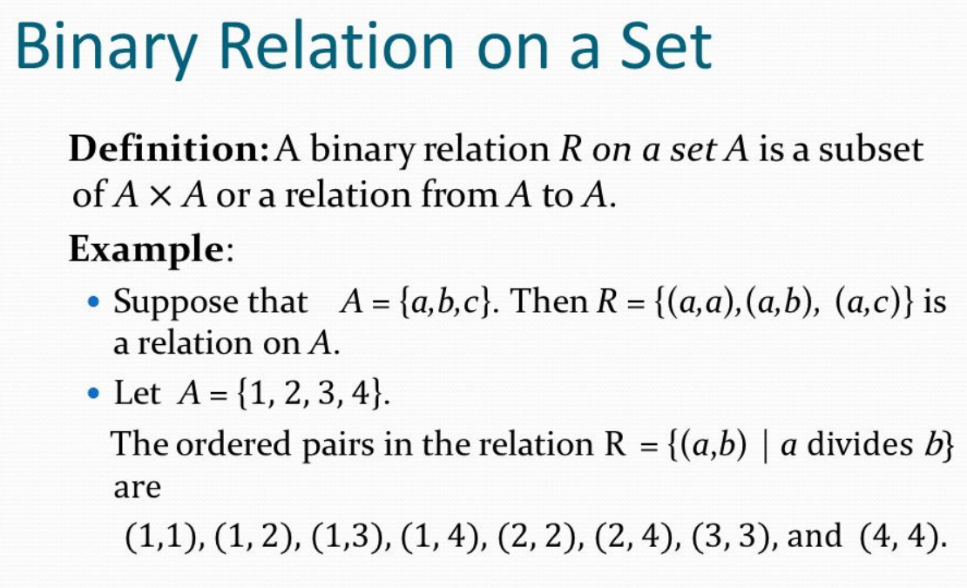
FREE: For Complete Playlist: https://www.youtube.com/c/FahadHussaintutorial/playlists
For Code, Slide and Books: https://fahadhussaincs.blogspot.com/

Slide 6
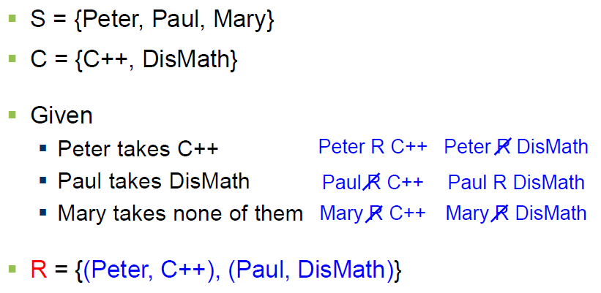
Binary Relations
EXAMPLE #1:
FREE: For Complete Playlist: https://www.youtube.com/c/FahadHussaintutorial/playlists
For Code, Slide and Books: https://fahadhussaincs.blogspot.com/

Slide 7
Domain and Range of a Relation
DOMAIN OF A RELATION:
The domain of a relation R from A to B is the set of all first elements of the ordered pairs which belong to R denoted by Dom(R).
Symbolically, Dom (R) = {a ∈A | (a, b) ∈R}
RANGE OF A RELATION:
The range of a relation R from A to B is the set of all second elements of the ordered pairs which belong to R denoted Ran(R).
Symbolically, Ran(R) = {b ∈B | (a, b) ∈ R}
FREE: For Complete Playlist: https://www.youtube.com/c/FahadHussaintutorial/playlists
For Code, Slide and Books: https://fahadhussaincs.blogspot.com/

Slide 8
Domain and Range of a Relation
EXERCISE:
Let A = {1, 2}, B = {1, 2, 3},
Define a binary relation R from A to B as follows:
R = {(a, b) ∈A × B | a < b} Then
a. Find the ordered pairs in R.
b. Find the Domain and Range of R.
c. Is 1R3, 2R2?
SOLUTION:
Given A = {1, 2}, B = {1, 2, 3},
A × B = {(1,1), (1,2), (1,3), (2,1), (2,2), (2,3)}
a. R = {(a, b) ∈A × B | a < b}
R = {(1,2), (1,3), (2,3)}
FREE: For Complete Playlist: https://www.youtube.com/c/FahadHussaintutorial/playlists
For Code, Slide and Books: https://fahadhussaincs.blogspot.com/

Slide 9
Domain and Range of a Relation
Given A = {1, 2}, B = {1, 2, 3},
A × B = {(1,1), (1,2), (1,3), (2,1), (2,2), (2,3)}
b. Find the Domain and Range of R.
Solution:
Dom(R) = {1,2} and Ran(R) = {2, 3}
c. Is 1R3, 2R2?
Solution:
c. Since (1, 3)∈R so 1R3.
Since (2, 2)∈R so 2R2.
FREE: For Complete Playlist: https://www.youtube.com/c/FahadHussaintutorial/playlists
For Code, Slide and Books: https://fahadhussaincs.blogspot.com/

Slide 10
Representing Relations

Slide 11
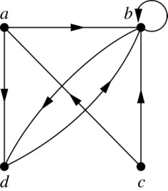
Representing Relations Using Digraphs
Definition: A directed graph, or digraph, consists of a set V of vertices (or nodes) together with a set E of ordered pairs of elements of V called edges (or arcs). The vertex a is called the initial vertex of the edge (a,b), and the vertex b is called the terminal vertex of this edge.
An edge of the form (a,a) is called a loop.
Example: A drawing of the directed graph with vertices a, b, c, and d, and edges (a, b), (a, d), (b, b), (b, d), (c, a), (c, b), and (d, b) is shown here.
FREE: For Complete Playlist: https://www.youtube.com/c/FahadHussaintutorial/playlists
For Code, Slide and Books: https://fahadhussaincs.blogspot.com/

Slide 12
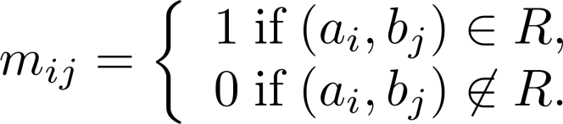
Representing Relations Using Matrices
A relation between finite sets can be represented using a zero-one matrix.
Suppose R is a relation from A = {a₁, a₂, …, a_{m}} to B = {b₁, b₂, …, b_{n}}.
The elements of the two sets can be listed in any particular arbitrary order. When A = B, we use the same ordering.
The relation R is represented by the matrix M_{R} = [m_{ij}], where
The matrix representing R has a 1 as its (i,j) entry when a_{i} is related to b_{j} and a 0 if a_{i} is not related to b_{j}.
FREE: For Complete Playlist: https://www.youtube.com/c/FahadHussaintutorial/playlists
For Code, Slide and Books: https://fahadhussaincs.blogspot.com/

Slide 13
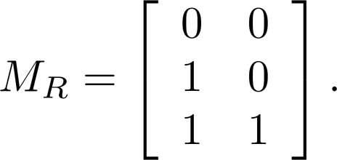
Examples of Representing Relations Using Matrices
Example 1: Suppose that A = {1,2,3} and B = {1,2}. Let R be the relation from A to B containing (a,b) if a ∈ A, b ∈ B, and a > b. What is the matrix representing R (assuming the ordering of elements is the same as the increasing numerical order)?
Solution: Because R = {(2,1), (3,1),(3,2)}, the matrix is
FREE: For Complete Playlist: https://www.youtube.com/c/FahadHussaintutorial/playlists
For Code, Slide and Books: https://fahadhussaincs.blogspot.com/

Slide 14
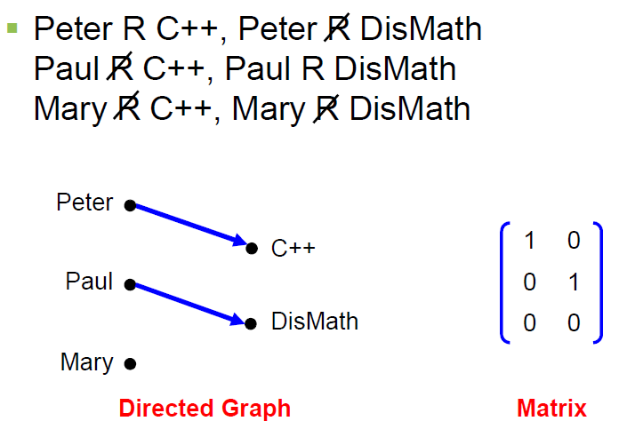
Binary Relations
EXAMPLE #1: (cont.)
FREE: For Complete Playlist: https://www.youtube.com/c/FahadHussaintutorial/playlists
For Code, Slide and Books: https://fahadhussaincs.blogspot.com/

Slide 15
Binary Relation on a Set
Definition: A binary relation R on a set A is a subset of A × A or a relation from A to A.
Example:
Suppose that A = {a,b,c}. Then R = {(a,a),(a,b), (a,c)} is a relation on A.
Let A = {1, 2, 3, 4}. The ordered pairs in the relation R = {(a,b) | a divides b} are
{(1,1), (1, 2), (1,3), (1, 4), (2, 2), (2, 4), (3, 3), and (4, 4)}.
REMARK:
For any set A
1. A × A is known as the universal relation.
2. ∅ is known as the empty relation.
FREE: For Complete Playlist: https://www.youtube.com/c/FahadHussaintutorial/playlists
For Code, Slide and Books: https://fahadhussaincs.blogspot.com/

Slide 16
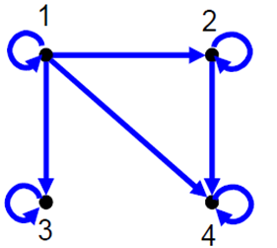
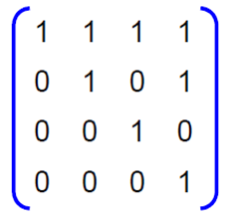
Binary Relation on a Set
FREE: For Complete Playlist: https://www.youtube.com/c/FahadHussaintutorial/playlists
For Code, Slide and Books: https://fahadhussaincs.blogspot.com/

Slide 17
Relations and Their Properties

Slide 18
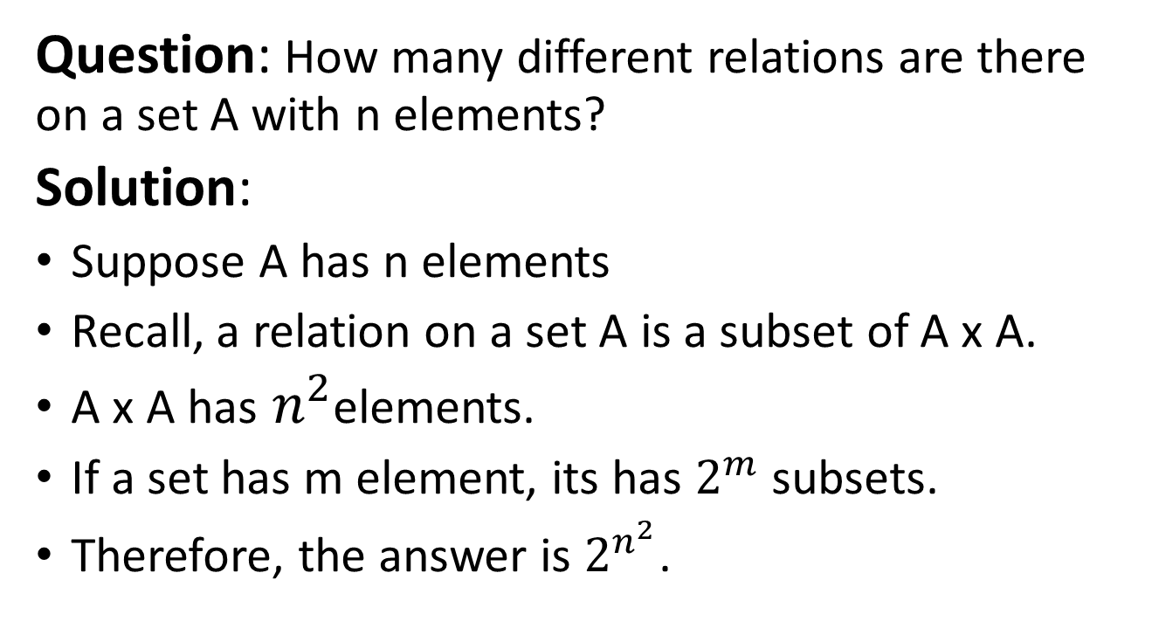
Binary Relation on a Set (cont.)
Question: How many different relations are there on a set A with n elements?
Solution:
Suppose A has n elements
Recall, a relation on a set A is a subset of A x A.
A x A has $n^{2}$elements.
If a set has m element, its has $2^{m}$ subsets.
Therefore, the answer is $2^{n^{2}}$.
FREE: For Complete Playlist: https://www.youtube.com/c/FahadHussaintutorial/playlists
For Code, Slide and Books: https://fahadhussaincs.blogspot.com/

Slide 19
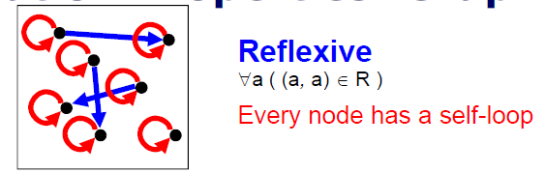
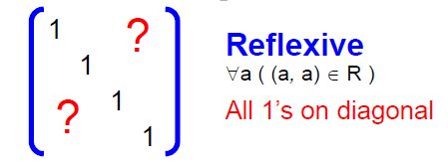
Reflexive Relations
Definition: R is reflexive iff (a,a) ∊ R for every element a ∊ A. Written symbolically, R is reflexive if and only if
∀a[a∊U ⟶ (a,a) ∊ R]
If A = ∅ then the empty relation is reflexive vacuously. That is the empty relation on an empty set is reflexive!
FREE: For Complete Playlist: https://www.youtube.com/c/FahadHussaintutorial/playlists
For Code, Slide and Books: https://fahadhussaincs.blogspot.com/

Slide 20
Reflexive Relations
EXAMPLE: Let A = {1, 2, 3, 4} and determine whether relations R1, R2, R3, and R4 are Reflexive?
R1 = {(1, 1), (3, 3), (2, 2), (4, 4)}
R2 = {(1, 1), (1, 4), (2, 2), (3, 3), (4, 3)}
R3 = {(1, 1), (1, 2), (2, 1), (2, 2), (3, 3), (4, 4)}
R4 = {(1, 3), (2, 2), (2, 4), (3, 1), (4, 4)}
Solution:
R1 is reflexive, since (a, a) ∈R1 for all a ∈A.
R2 is not reflexive, because (4, 4) ∉R2.
R3 is reflexive, since (a, a) ∈R3 for all a ∈A.
R4 is not reflexive, because (1, 1) ∉R4, (3, 3) ∉R4.
FREE: For Complete Playlist: https://www.youtube.com/c/FahadHussaintutorial/playlists
For Code, Slide and Books: https://fahadhussaincs.blogspot.com/

Slide 21
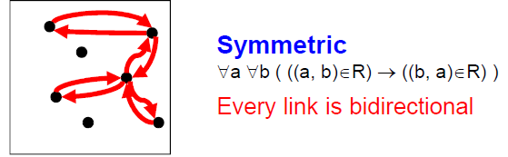
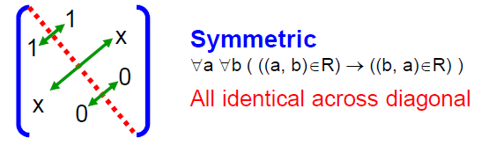
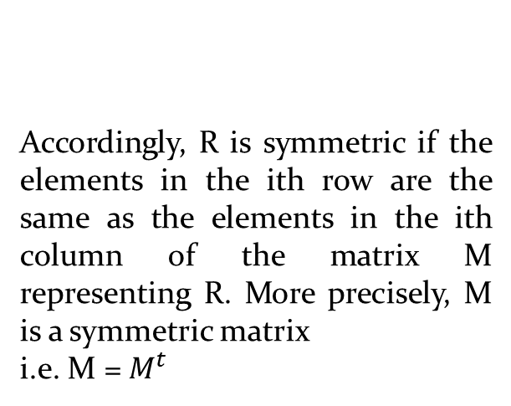
Symmetric Relations
Definition: R is symmetric iff (b,a) ∊ R whenever (a,b) ∊ R for all a,b ∊ A. Written symbolically, R is symmetric if and only if
∀a∀b [(a,b) ∊R ⟶ (b,a) ∊ R]
More precisely, M is a
symmetric matrix i.e. M = Mt
Accordingly, R is symmetric if the elements in the ith row are the same as the elements in the ith column of the matrix M representing R. More precisely, M is a symmetric matrix
i.e. M = $M^{t}$
FREE: For Complete Playlist: https://www.youtube.com/c/FahadHussaintutorial/playlists
For Code, Slide and Books: https://fahadhussaincs.blogspot.com/

Slide 22
Symmetric Relations
EXAMPLE: Let A = {1, 2, 3, 4} and determine whether relations R1, R2, R3, and R4 are Symmetric?
R1 = {(1, 1), (1, 3), (2, 4), (3, 1), (4,2)}
R2 = {(1, 1), (2, 2), (3, 3), (4, 4)}
R3 = {(2, 2), (2, 3), (3, 4)}
R4 = {(1, 1), (2, 2), (3, 3), (4, 3), (4, 4)}
Solution:
R1 is Symmetric, since (a, b) and (b, a) ∈R1 for all (a, b) ∈A.
R2 is also symmetric. We say it is vacuously true.
R3 is not symmetric, because (2,3) ∈ R3 but (3,2) ∉ R3.
R4 is not symmetric because (4,3) ∈ R4 but (3,4) ∉ R4.
FREE: For Complete Playlist: https://www.youtube.com/c/FahadHussaintutorial/playlists
For Code, Slide and Books: https://fahadhussaincs.blogspot.com/

Slide 23
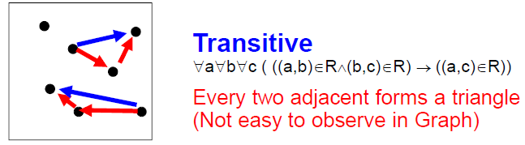
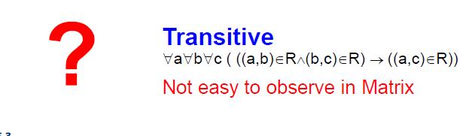
Transitive Relations
Definition: A relation R on a set A is called transitive if whenever (a,b) ∊ R and (b,c) ∊ R, then (a,c) ∊ R, for all a,b,c ∊ A. Written symbolically, R is transitive if and only if
∀a∀b ∀c[(a,b) ∊R ∧ (b,c) ∊ R ⟶ (a,c) ∊ R ]
For a transitive directed graph, whenever there is an arrow going from one point
to the second, and from the second to the third, there is an arrow going directly from the
first to the third.

Slide 24
Transitive Relations
EXAMPLE: Let A = {1, 2, 3, 4} and determine whether relations R1, R2 and R3 are Transitive?
R1 = {(1, 1), (1, 2), (1, 3), (2, 3)}
R2 = {(1, 2), (1, 4), (2, 3), (3, 4)}
R3 = {(2, 1), (2, 4), (2, 3), (3,4)}
Solution:
R1 is transitive because (1, 1), (1, 2) are in R, then to be transitive relation(1,2) must be there and it belongs to R.
R2 is not transitive since (1,2) and (2,3) ∈ R2 but (1,3) ∉ R2.
R3 is transitive.(check by definition)
FREE: For Complete Playlist: https://www.youtube.com/c/FahadHussaintutorial/playlists
For Code, Slide and Books: https://fahadhussaincs.blogspot.com/

Slide 25
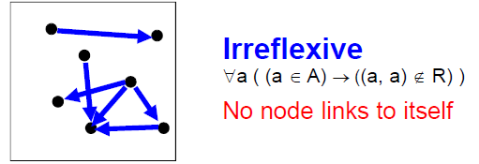
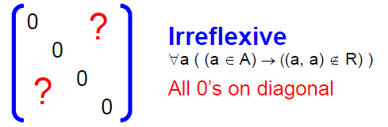
Irreflexive Relations
Definition: R is irreflexive iff for all a∈A,(a,a) ∉R. That is, R is irreflexive if no element in A is related to itself by R.
Written symbolically, R is irreflexive if and only if
∀a [(a ∊A) ⟶ (a , a)∉ R]
R is not irreflexive iff there is an element a∈A such that (a,a) ∈R.
FREE: For Complete Playlist: https://www.youtube.com/c/FahadHussaintutorial/playlists
For Code, Slide and Books: https://fahadhussaincs.blogspot.com/

Slide 26
Irreflexive Relations
EXAMPLE: Let A = {1, 2, 3, 4} and determine whether relations R1, R2 and R3 are Irreflexive?
R1 = {(1,3), (1,4), (2,3), (2,4), (3,1), (3,4)}
R2 = {(1,1), (1,2), (2,1), (2,2), (3,3), (4,4)}
R3= {(1,2), (2,3), (3,3), (3,4)}
Solution:
R1 is irreflexive since no element of A is related to itself in R1. i.e. (1,1)∉ R1, (2,2) ∉ R1, (3,3) ∉ R1,(4,4) ∉ R1.
R2 is not irreflexive, since all elements of A are related to themselves in R2.
R3 is not irreflexive since (3,3) ∈R3. Note that R3 is not reflexive.
FREE: For Complete Playlist: https://www.youtube.com/c/FahadHussaintutorial/playlists
For Code, Slide and Books: https://fahadhussaincs.blogspot.com/

Slide 27
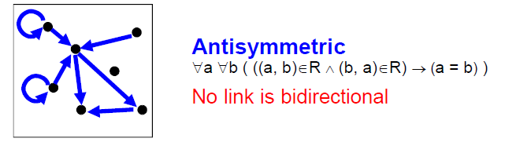
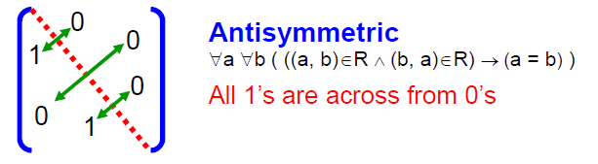
Antisymmetric Relations
Definition: A relation R on a set A such that for all a,b ∊ A if (a,b) ∊ R and (b,a) ∊ R, then a = b is called antisymmetric. Written symbolically, R is antisymmetric if and only if ∀a∀b [(a,b) ∊R ∧ (b,a) ∊ R ⟶ a = b]
Note: (a,a) may be an element in R.
Let R be an anti-symmetric relation on a set A = {a1, a2, …, an}. Then if (ai, aj) ∈R for
i ≠ j then (ai, aj) ∉R.
Thus in the matrix representation of R there is a 1 in the ith row and jth column
iff the jth row and ith column contains 0 vice versa.

Slide 28
Antisymmetric Relations
EXAMPLE: Let A = {1, 2, 3, 4} and determine whether relations R1, R2, R3, and R4 are Antisymmetric?
R1 = {(1,1),(2,2),(3,3)}
R2 = {(1,2),(2,2), (2,3), (3,4), (4,1)}
R3={(1,3),(2,2), (2,4), (3,1), (4,2)}
R4={(1,3),(2,4), (3,1), (4,3)}
Solution:
R1 is anti-symmetric and symmetric.
R2 is anti-symmetric but not symmetric because (1,2) ∈ R2 but (2,1) ∉ R2.
R3 is not anti-symmetric since (1,3) & (3,1) ∈ R3 but 1 ≠ 3. Note that R3 is symmetric.
R4 is neither anti-symmetric because (1,3) & (3,1) ∈ R4 but 1 ≠ 3 nor symmetric because (2,4) ∈ R4 but (4,2) ∉R4.
FREE: For Complete Playlist: https://www.youtube.com/c/FahadHussaintutorial/playlists
For Code, Slide and Books: https://fahadhussaincs.blogspot.com/

Slide 29
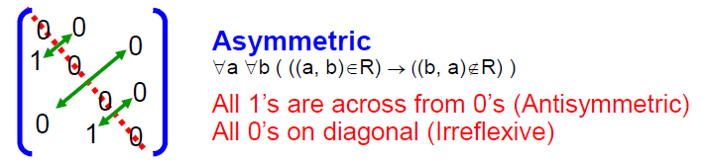
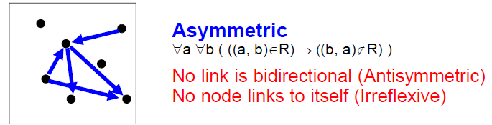
Asymmetric Relations
Definition: R is Asymmetric iff for all (a,b) ∊R than (b ,a)∉R. Written symbolically, R is Asymmetric if and only if
∀a ∀b[((a,b) ∊R)) ⟶ ((b , a)∉ R)]
Note:(a,a) cannot be an element in R.
Asymmetry = Antisymmetry + Irreflexivity

Slide 30
Asymmetric Relations
EXAMPLE: Let A = {1, 2, 3, 4} and determine whether relations R1, R2 and R3 are Asymmetric?
R1 = {(1,1), (1,2), (2,1), (2,2), (3,4), (4,1), (4,4)}
R2 = {(1,2),(2,3),(3,4)}
R3 = {(2,3),(3,3),(3,4)}
Solution:
R1 is not Asymmetric since R1 is neither Antisymmetric nor Irreflexive.
R2 is Asymmetric since R2 is both Antisymmetric and Irreflexive.
R3 is not Asymmetric since it is Antisymmetric but not irreflexive.
FREE: For Complete Playlist: https://www.youtube.com/c/FahadHussaintutorial/playlists
For Code, Slide and Books: https://fahadhussaincs.blogspot.com/

Slide 31

Activity Time

Slide 32
Consider the following relations on {1, 2, 3, 4}:
R1 = {(1, 1), (1, 2), (2, 1), (2, 2), (3, 4), (4, 1), (4, 4)},
R2 = {(1, 1), (1, 2), (2, 1)},
R3 = {(1, 1), (1, 2), (1, 4), (2, 1), (2, 2), (3, 3), (4, 1), (4, 4)},
R4 = {(2, 1), (3, 1), (3, 2), (4, 1), (4, 2), (4, 3)},
R5 = {(1, 1), (1, 2), (1, 3), (1, 4), (2, 2), (2, 3), (2, 4), (3, 3), (3, 4), (4, 4)},
R6 = {(3, 4)}.
Determine which of these relation are Reflexive, Symmetric, Transitive, Antisymmetric, Irreflexive and Asymmetric.
FREE: For Complete Playlist: https://www.youtube.com/c/FahadHussaintutorial/playlists
For Code, Slide and Books: https://fahadhussaincs.blogspot.com/

Slide 33
Combining Relations
As R is a subsets of A x B, the set operations can be applied
Union (U)
Intersection (∩)
Difference (-)
Symmetric Complement (⊕)
Given two relations R₁ and R₂, we can combine them using basic set operations to form new relations such as R₁ ∪ R₂, R₁ ∩ R₂, R₁ − R₂, R₂ − R₁ and R₁ ⊕ R₂.
FREE: For Complete Playlist: https://www.youtube.com/c/FahadHussaintutorial/playlists
For Code, Slide and Books: https://fahadhussaincs.blogspot.com/

Slide 34
Domain and Range of a Relation
Given, A = {1,2,3}, B = {1,2,3,4}
R1 = {(1,1),(2,2),(3,3)},
R2 = {(1,1),(1,2),(1,3),(1,4)}
R1 U R2 = {(1,1),(1,2),(1,3),(1,4),(2,2),(3,3)}
R1 ∩ R2 = {(1,1)}
R1 - R2 = {(2,2),(3,3)}
R2 - R1 = {(1,2),(1,3),(1,4)}
R1 ⊕ R2 = {(1,2),(1,3),(1,4),(2,2),(3,3)}
FREE: For Complete Playlist: https://www.youtube.com/c/FahadHussaintutorial/playlists
For Code, Slide and Books: https://fahadhussaincs.blogspot.com/

Slide 35
Composition of Relations
Definition: Suppose
R₁ is a relation from a set A to a set B.
R₂ is a relation from B to a set C.
Then the composition (or composite) of R₂ with R₁, is a relation from A to C where
if (x,y) is a member of R₁ and (y,z) is a member of R₂, then (x,z) is a member of R₂∘ R₁.
FREE: For Complete Playlist: https://www.youtube.com/c/FahadHussaintutorial/playlists
For Code, Slide and Books: https://fahadhussaincs.blogspot.com/

Slide 36
Representing the Composition of a Relation
R₁
R₂
w
m
a
x
n
b
y
o
c
p
z
FREE: For Complete Playlist: https://www.youtube.com/c/FahadHussaintutorial/playlists
For Code, Slide and Books: https://fahadhussaincs.blogspot.com/

Slide 37
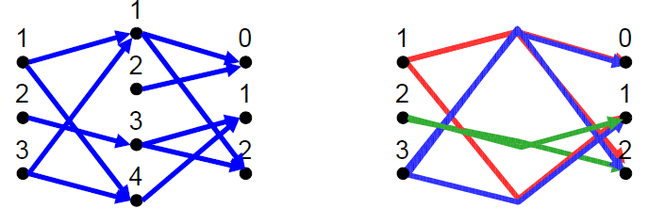
Composition of Relations
What is the composite of the relations R and S, where
R is the relation from {1,2,3} to {1,2,3,4} with
R = {(1,1),(1,4),(2,3),(3,1),(3,4)}
S is the relation from {1,2,3,4} to {0,1,2} with
S = {(1,0),(1,2),(2,0),(3,1),(3,2),(4,1)}?
S o R = {(1,0),(1,2),(1,1), (2,2),(2,1), (3,0),(3,2),(3,1)}

Slide 38
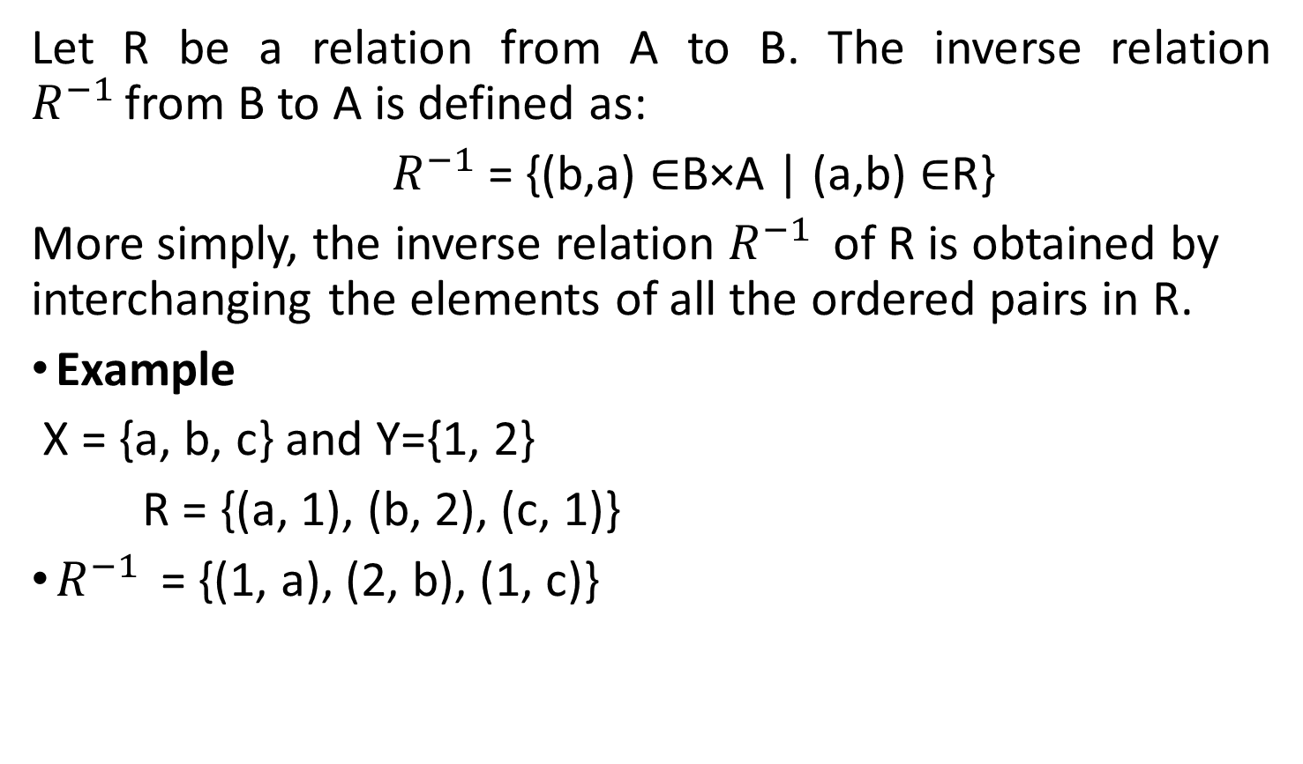
INVERSE OF A RELATION
Let R be a relation from A to B. The inverse relation $R^{−1 }$from B to A is defined as:
${ R}^{−1}$= {(b,a) ∈B×A | (a,b) ∈R}
More simply, the inverse relation $R^{−1 }$of R is obtained by interchanging the elements of all the ordered pairs in R.
Example
X = {a, b, c} and Y={1, 2}
R = {(a, 1), (b, 2), (c, 1)}
$R^{−1 }$= {(1, a), (2, b), (1, c)}
FREE: For Complete Playlist: https://www.youtube.com/c/FahadHussaintutorial/playlists
For Code, Slide and Books: https://fahadhussaincs.blogspot.com/

Slide 39
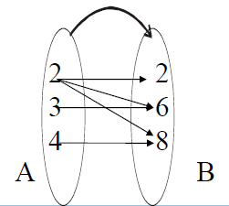
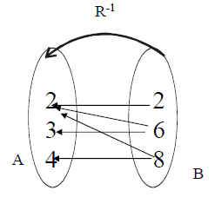
INVERSE OF A RELATION
The relation
R = {(2,2), (2,6), (2,8), (3,6), (4,8)} is represented by the arrow diagram.
Then inverse of the above relation can be obtained simply changing the directions of the arrows and hence the diagram is
FREE: For Complete Playlist: https://www.youtube.com/c/FahadHussaintutorial/playlists
For Code, Slide and Books: https://fahadhussaincs.blogspot.com/

Slide 40
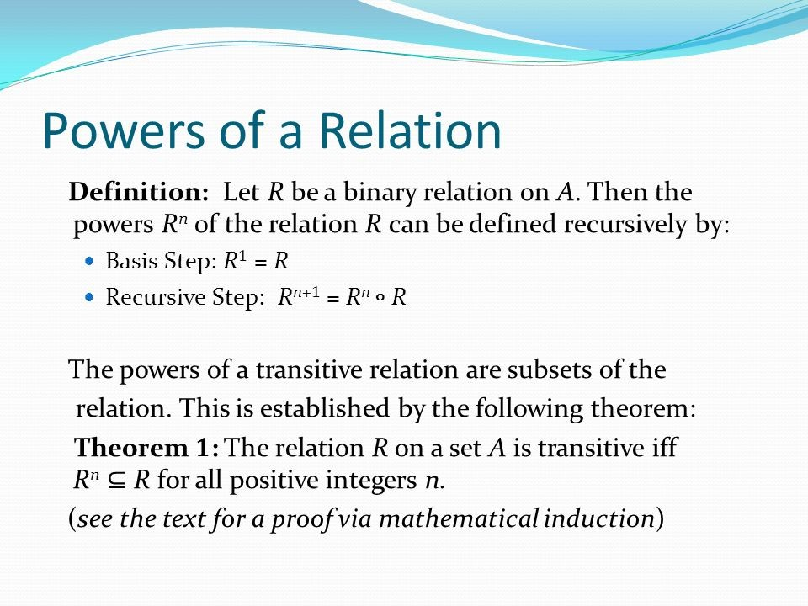
FREE: For Complete Playlist: https://www.youtube.com/c/FahadHussaintutorial/playlists
For Code, Slide and Books: https://fahadhussaincs.blogspot.com/

Slide 41
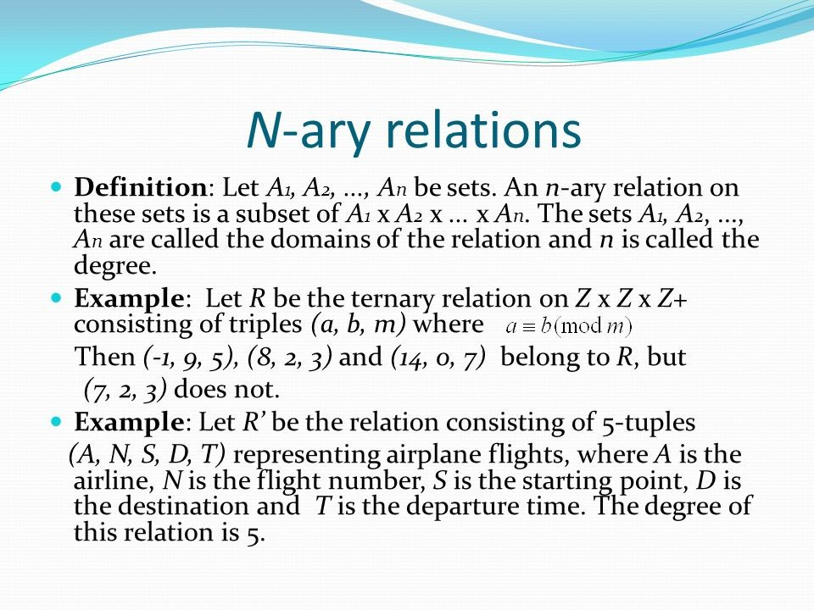
9.2 n-ary Relations and Their Applications
FREE: For Complete Playlist: https://www.youtube.com/c/FahadHussaintutorial/playlists
For Code, Slide and Books: https://fahadhussaincs.blogspot.com/

Slide 42
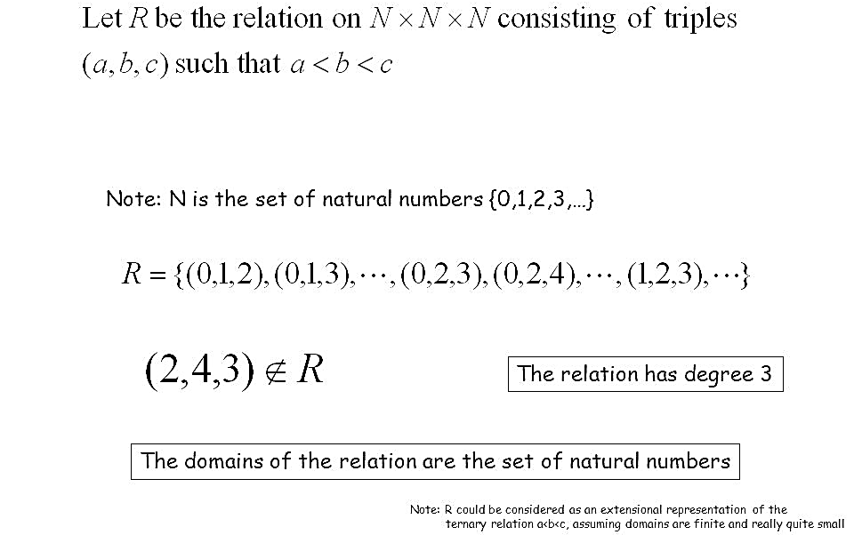
9.2 n-ary Relations and Their Applications
FREE: For Complete Playlist: https://www.youtube.com/c/FahadHussaintutorial/playlists
For Code, Slide and Books: https://fahadhussaincs.blogspot.com/

Slide 43
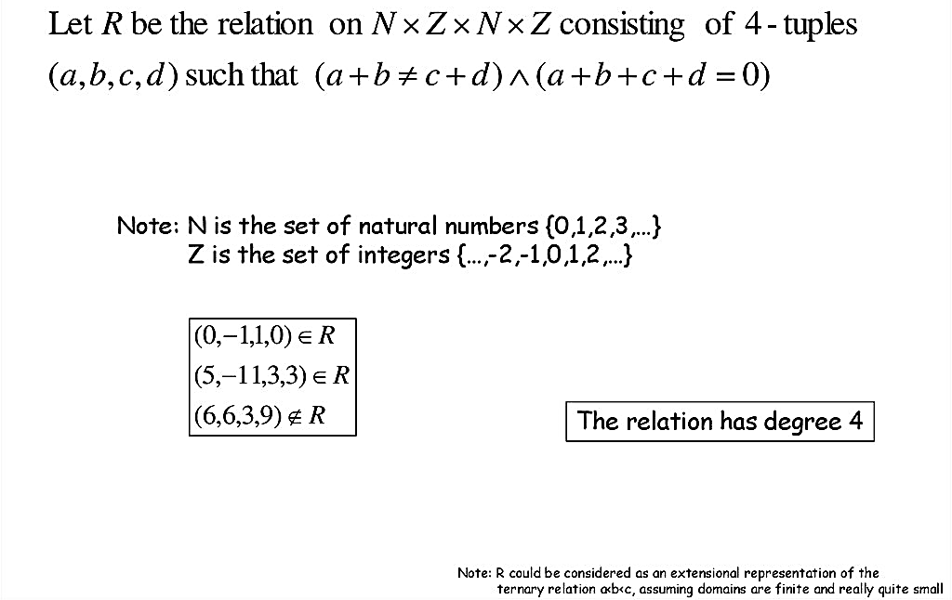
9.2 n-ary Relations and Their Applications
FREE: For Complete Playlist: https://www.youtube.com/c/FahadHussaintutorial/playlists
For Code, Slide and Books: https://fahadhussaincs.blogspot.com/

Slide 44
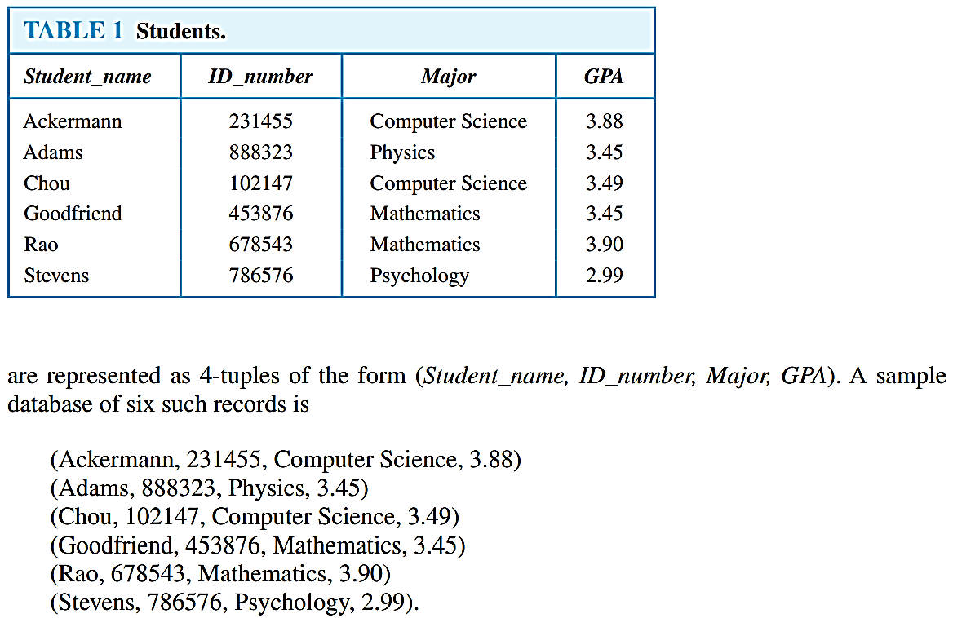
Databases and Relations
A database consists of records, which are n-tuples, made up of fields. The fields are the entries of the n-tuples. For instance, a database of student records may be made up of fields containing the name, student number, major, and grade point average of the student. The relational data model represents a database of records as an n-ary relation. Thus, student records
FREE: For Complete Playlist: https://www.youtube.com/c/FahadHussaintutorial/playlists
For Code, Slide and Books: https://fahadhussaincs.blogspot.com/

Slide 45
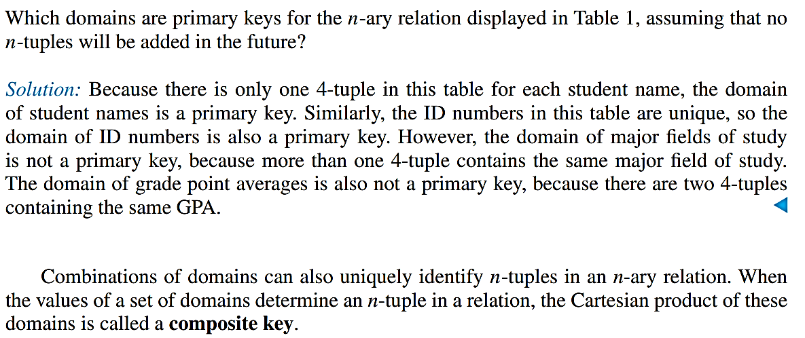
Databases and Relations
Records are often added to or deleted from databases. Because of this, the property that a domain is a primary key is time-dependent. Consequently, a primary key should be chosen that remains one whenever the database is changed. The current collection of n-tuples in a relation is called the extension of the relation. The more permanent part of a database, including the name and attributes of the database, is called its intension. When selecting a primary key, the goal should be to select a key that can serve as a primary key for all possible extensions of the database. To do this, it is necessary to examine the intension of the database to understand the set of possible n-tuples that can occur in an extension
FREE: For Complete Playlist: https://www.youtube.com/c/FahadHussaintutorial/playlists
For Code, Slide and Books: https://fahadhussaincs.blogspot.com/

Slide 46
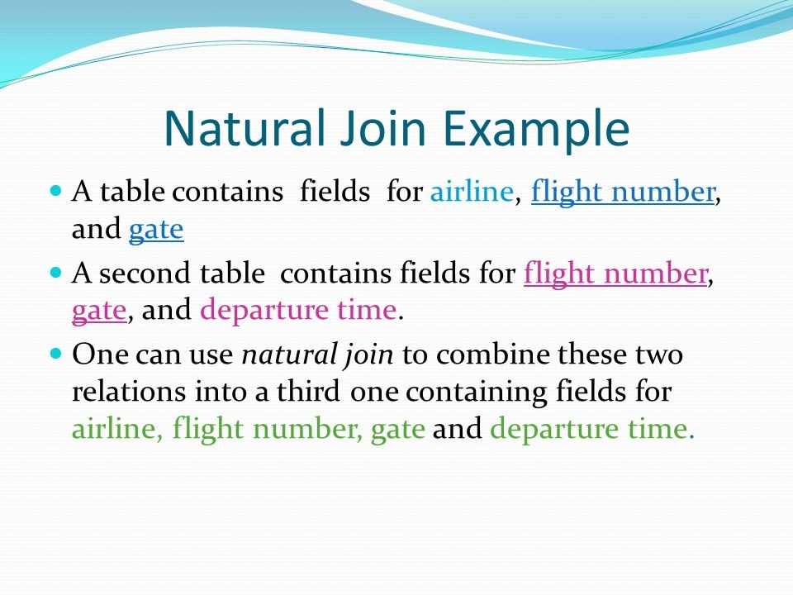
FREE: For Complete Playlist: https://www.youtube.com/c/FahadHussaintutorial/playlists
For Code, Slide and Books: https://fahadhussaincs.blogspot.com/

Slide 47
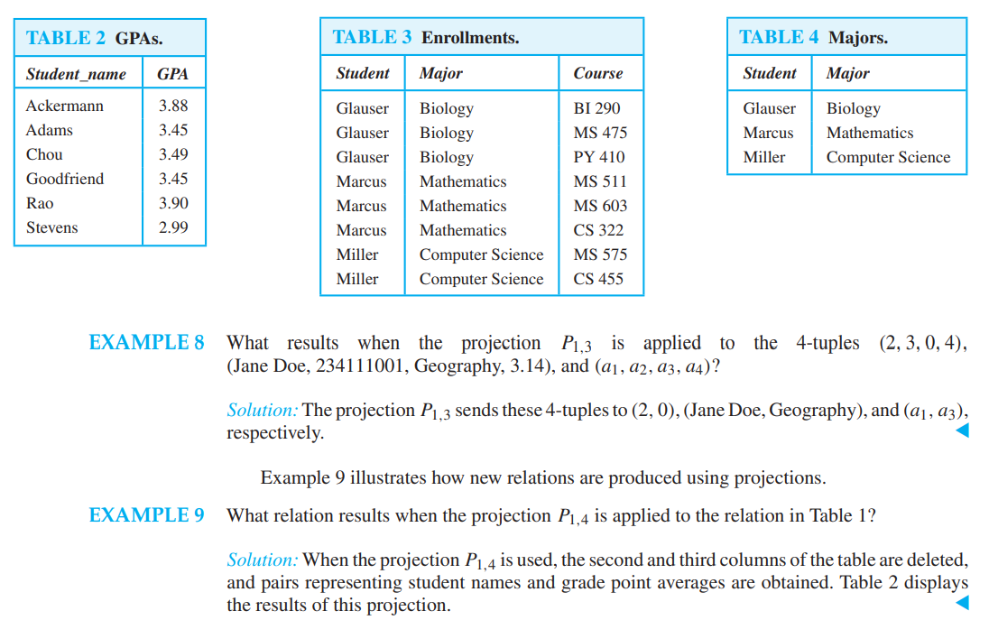
Operations on n-ary Relations
FREE: For Complete Playlist: https://www.youtube.com/c/FahadHussaintutorial/playlists
For Code, Slide and Books: https://fahadhussaincs.blogspot.com/

Slide 48
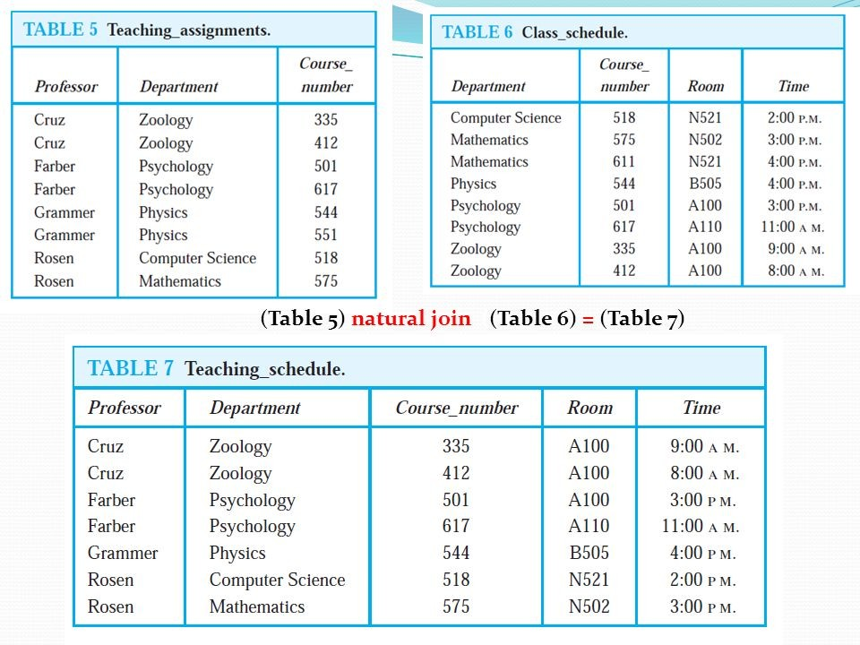

Slide 49
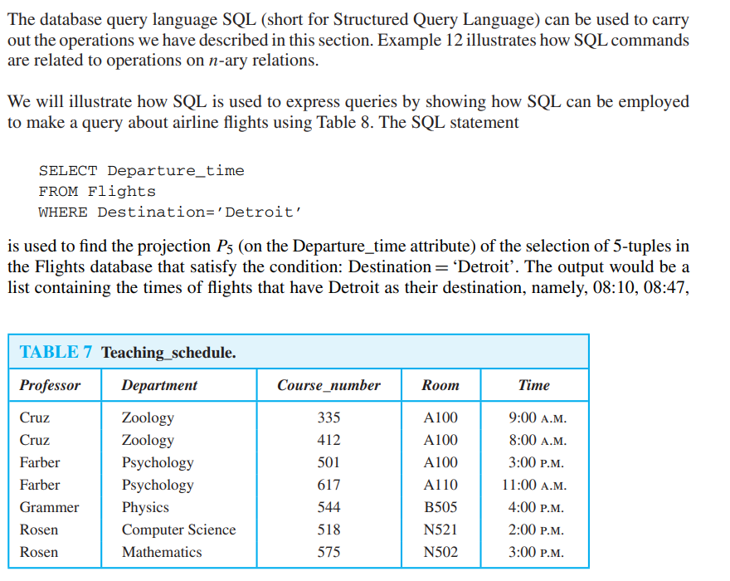
SQL
FREE: For Complete Playlist: https://www.youtube.com/c/FahadHussaintutorial/playlists
For Code, Slide and Books: https://fahadhussaincs.blogspot.com/

Slide 50
9.3 Representing Relations

Slide 51
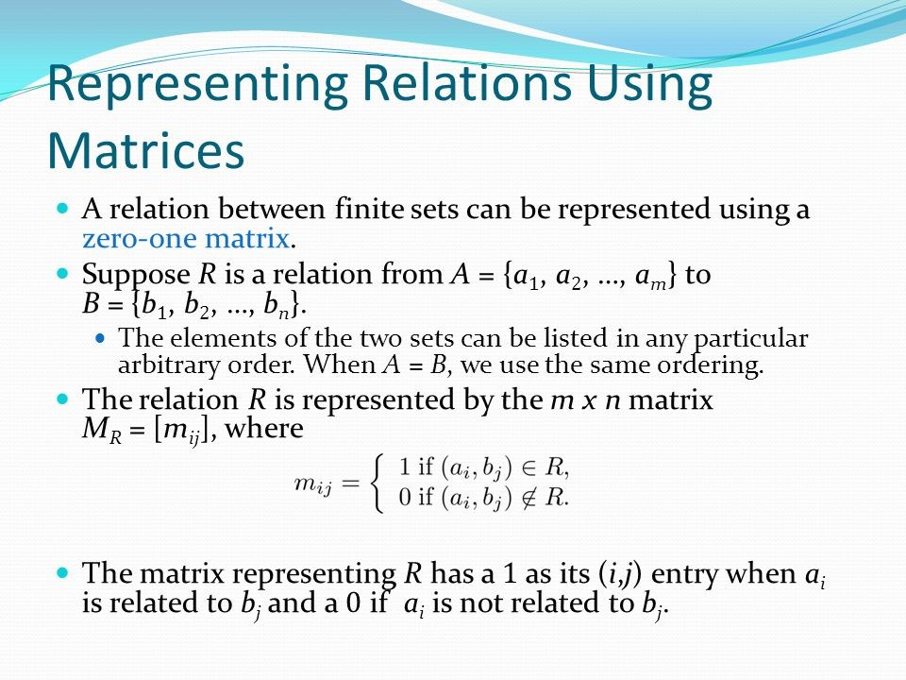

Slide 52
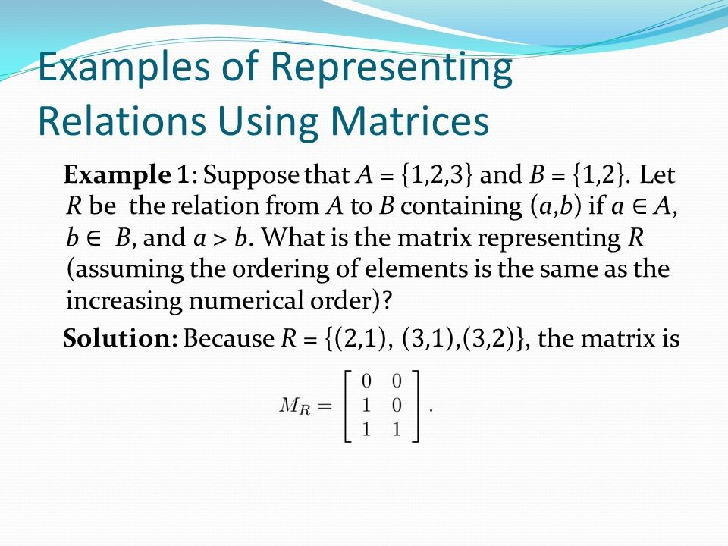
FREE: For Complete Playlist: https://www.youtube.com/c/FahadHussaintutorial/playlists
For Code, Slide and Books: https://fahadhussaincs.blogspot.com/

Slide 53
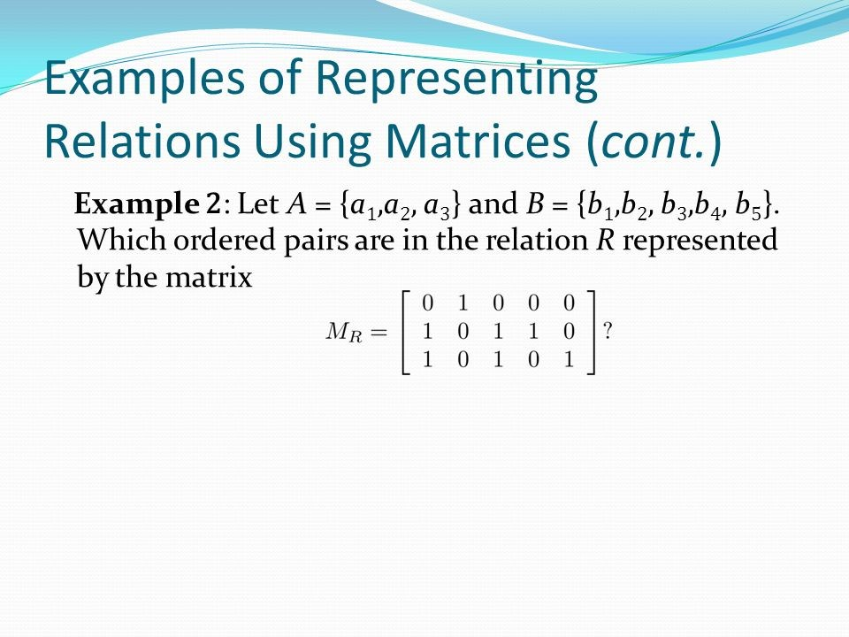
FREE: For Complete Playlist: https://www.youtube.com/c/FahadHussaintutorial/playlists
For Code, Slide and Books: https://fahadhussaincs.blogspot.com/

Slide 54
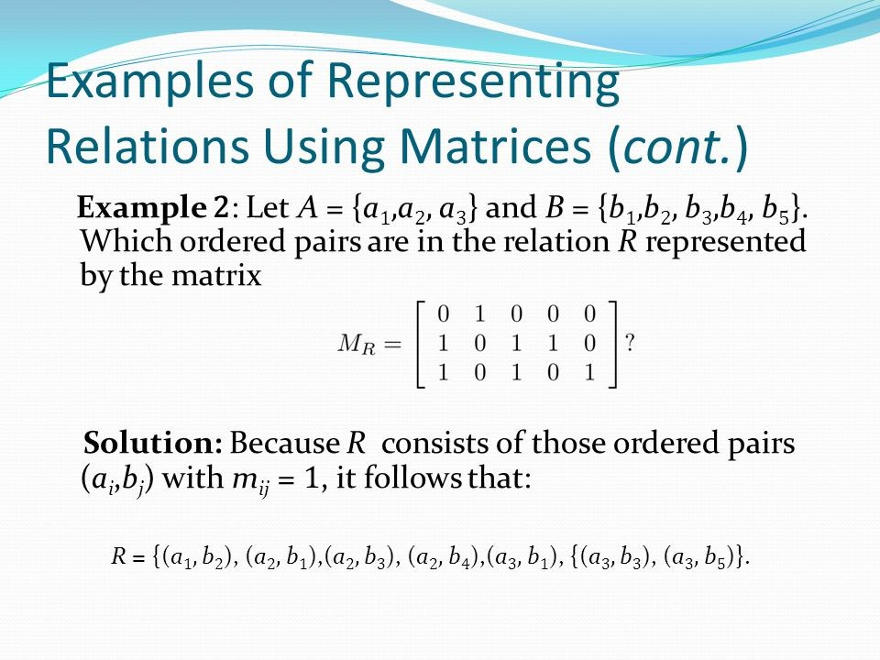
FREE: For Complete Playlist: https://www.youtube.com/c/FahadHussaintutorial/playlists
For Code, Slide and Books: https://fahadhussaincs.blogspot.com/

Slide 55
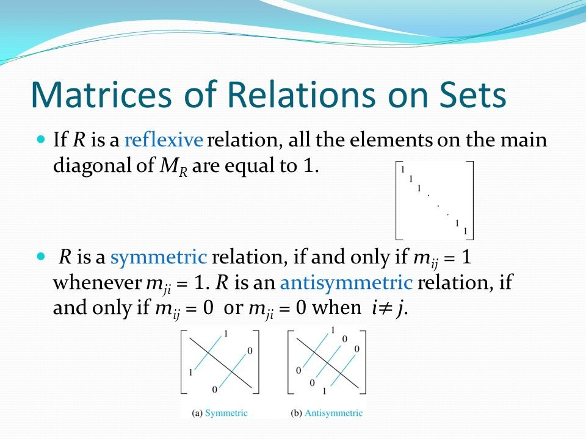

Slide 56
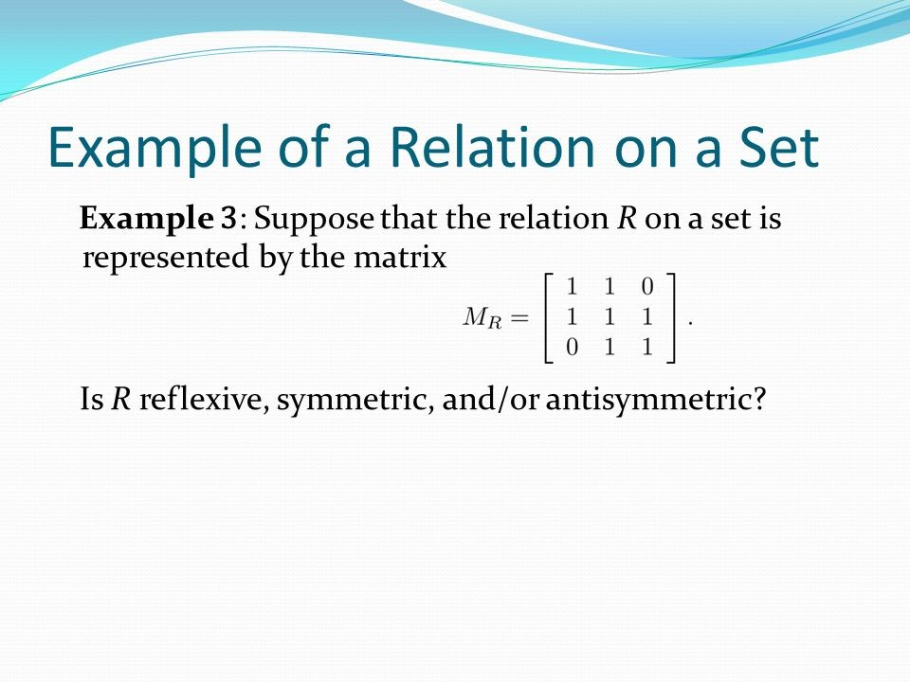
FREE: For Complete Playlist: https://www.youtube.com/c/FahadHussaintutorial/playlists
For Code, Slide and Books: https://fahadhussaincs.blogspot.com/

Slide 57
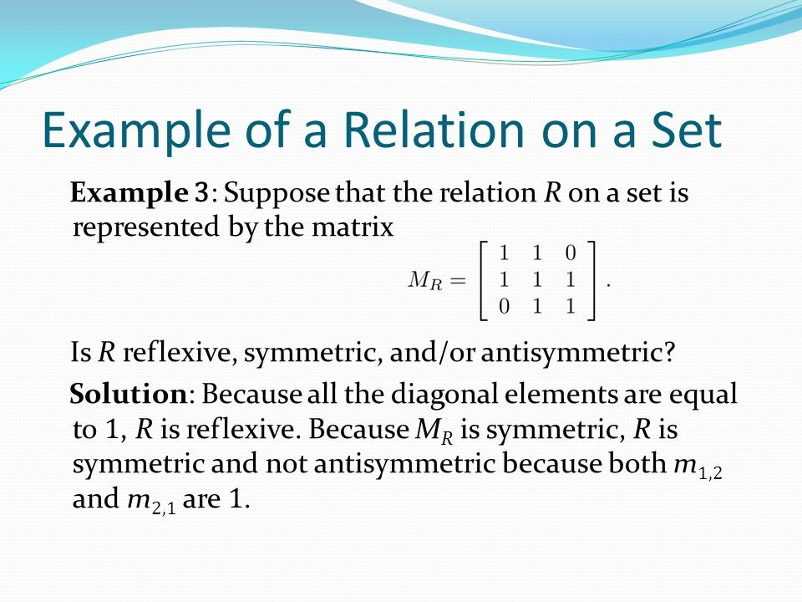
FREE: For Complete Playlist: https://www.youtube.com/c/FahadHussaintutorial/playlists
For Code, Slide and Books: https://fahadhussaincs.blogspot.com/

Slide 58
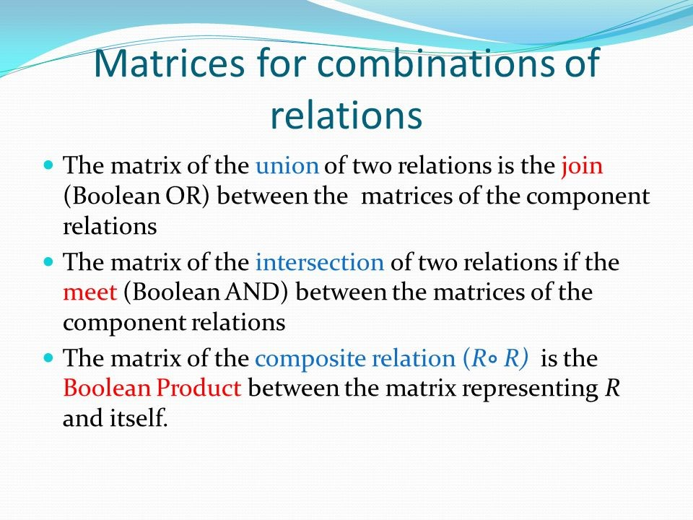
FREE: For Complete Playlist: https://www.youtube.com/c/FahadHussaintutorial/playlists
For Code, Slide and Books: https://fahadhussaincs.blogspot.com/

Slide 59
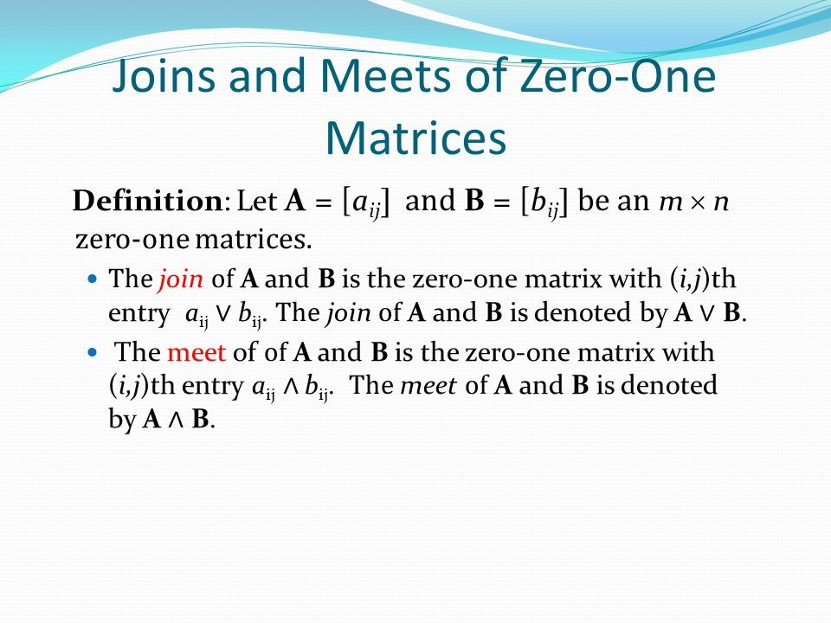
FREE: For Complete Playlist: https://www.youtube.com/c/FahadHussaintutorial/playlists
For Code, Slide and Books: https://fahadhussaincs.blogspot.com/

Slide 60
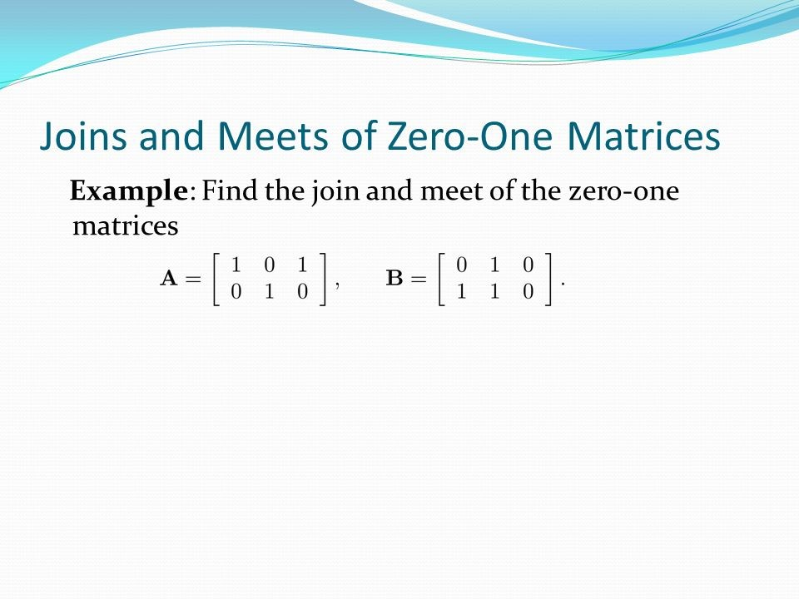

Slide 61
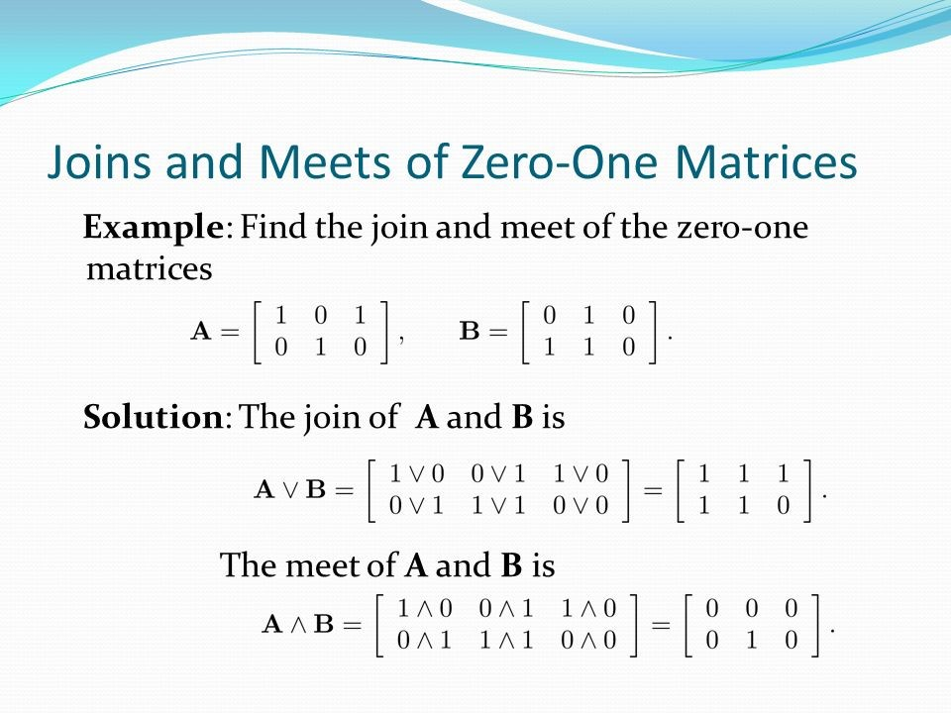

Slide 63
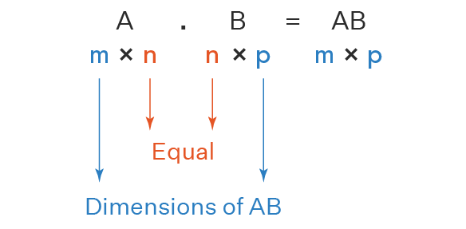
Multiplication Rules
FREE: For Complete Playlist: https://www.youtube.com/c/FahadHussaintutorial/playlists
For Code, Slide and Books: https://fahadhussaincs.blogspot.com/

Slide 64


Slide 65

FREE: For Complete Playlist: https://www.youtube.com/c/FahadHussaintutorial/playlists
For Code, Slide and Books: https://fahadhussaincs.blogspot.com/

Slide 66
FREE: For Complete Playlist: https://www.youtube.com/c/FahadHussaintutorial/playlists
For Code, Slide and Books: https://fahadhussaincs.blogspot.com/

Slide 67

FREE: For Complete Playlist: https://www.youtube.com/c/FahadHussaintutorial/playlists
For Code, Slide and Books: https://fahadhussaincs.blogspot.com/

Slide 68

FREE: For Complete Playlist: https://www.youtube.com/c/FahadHussaintutorial/playlists
For Code, Slide and Books: https://fahadhussaincs.blogspot.com/

Slide 69

FREE: For Complete Playlist: https://www.youtube.com/c/FahadHussaintutorial/playlists
For Code, Slide and Books: https://fahadhussaincs.blogspot.com/

Slide 70


Slide 71

FREE: For Complete Playlist: https://www.youtube.com/c/FahadHussaintutorial/playlists
For Code, Slide and Books: https://fahadhussaincs.blogspot.com/

Slide 72

FREE: For Complete Playlist: https://www.youtube.com/c/FahadHussaintutorial/playlists
For Code, Slide and Books: https://fahadhussaincs.blogspot.com/

Slide 73

FREE: For Complete Playlist: https://www.youtube.com/c/FahadHussaintutorial/playlists
For Code, Slide and Books: https://fahadhussaincs.blogspot.com/

Slide 74


Slide 75

FREE: For Complete Playlist: https://www.youtube.com/c/FahadHussaintutorial/playlists
For Code, Slide and Books: https://fahadhussaincs.blogspot.com/

Slide 76


Slide 77


Slide 78


Slide 79
9.4 Closures of Relations
What is Closures
A closure is a set of elements that is closed under a given Basic Operations:
Addition, Subtraction, Multiplication, Division
If you have a set and perform a specific operation on any two elements of the set, the result will also be an element of the set.
Example:
Natural Numbers are closed under Addition.
Natural Numbers are not closed under Subtraction.
The set of Even numbers is closed under addition. 4 The set of Odd numbers is not closed under addition.
FREE: For Complete Playlist: https://www.youtube.com/c/FahadHussaintutorial/playlists
For Code, Slide and Books: https://fahadhussaincs.blogspot.com/

Slide 80
9.4 Closures of Relations
What is Closures
If R is a relation on a set A, then the closure of R with respect to P, if it exists, is the relation S on A with property P that contains R and is a subset of every subset of A x A containing R with property P.
P: Reflexive, Symmetric, Antisymmetric, Transitive
The Closure of a relation R with respect to property P is the relation obtained by adding the minimum number of ordered pairs to R to obtain property P.
Closures are often used to create new relations from existing ones, or to study the properties of a given relation.
FREE: For Complete Playlist: https://www.youtube.com/c/FahadHussaintutorial/playlists
For Code, Slide and Books: https://fahadhussaincs.blogspot.com/

Slide 81
9.4 Closures of Relations
Three types we will study
Reflexive
Easy
Symmetric
Easy
Transitive
Hard
FREE: For Complete Playlist: https://www.youtube.com/c/FahadHussaintutorial/playlists
For Code, Slide and Books: https://fahadhussaincs.blogspot.com/

Slide 82
Reflexive closure
Consider a relation R:
From our MapQuest example in the last slide set
Note that it is not reflexive
We want to add edges to make the relation reflexive
By adding those edges, we have made a non- reflexive relation R into a reflexive relation
This new relation is called the reflexive closure of R
FREE: For Complete Playlist: https://www.youtube.com/c/FahadHussaintutorial/playlists
For Code, Slide and Books: https://fahadhussaincs.blogspot.com/

Slide 83
Reflexive closure
In order to find the reflexive closure of a relation R, we add a loop at each node that does not have one
The reflexive closure of R is R U Δ
Where Δ = { (a,a) | a ∈ R }
Called the “diagonal relation”
With matrices, we set the diagonal to all 1’s
FREE: For Complete Playlist: https://www.youtube.com/c/FahadHussaintutorial/playlists
For Code, Slide and Books: https://fahadhussaincs.blogspot.com/

Slide 84
Reflexive closure
Let R be a relation on the set { 0, 1, 2, 3 } containing the ordered pairs (0,1), (1,1), (1,2), (2,0), (2,2), and (3,0)
What is the reflexive closure of R?
We add all pairs of edges (a,a) that do not already exist
0
1
We add edges:
(0,0), (3,3)
3
2

Slide 85
Symmetric closure
Consider a relation R:
From our MapQuest example in the last slide set
Note that it is not symmetric
We want to add edges to make the relation symmetric
By adding those edges, we have made a non- symmetric relation R into a symmetric relation
This new relation is called the symmetric closure of R

Slide 86
Symmetric closure
In order to find the symmetric closure of a relation R, we add an edge from a to b, where there is already an edge from b to a
The symmetric closure of R is R U R⁻¹
If R = { (a,b) | … }
Then R⁻¹ = { (b,a) | … }
FREE: For Complete Playlist: https://www.youtube.com/c/FahadHussaintutorial/playlists
For Code, Slide and Books: https://fahadhussaincs.blogspot.com/

Slide 87
Symmetric closure
Let R be a relation on the set { 0, 1, 2, 3 } containing the ordered pairs (0,1), (1,1), (1,2), (2,0), (2,2), and (3,0)
What is the symmetric closure of R?
We add all pairs of edges (a,b) where (b,a) exists
We make all “single” edges into anti-parallel pairs
0
1
We add edges:
(0,2), (0,3)
(1,0), (2,1)
3
2
FREE: For Complete Playlist: https://www.youtube.com/c/FahadHussaintutorial/playlists
For Code, Slide and Books: https://fahadhussaincs.blogspot.com/

Slide 88
Paths in directed graphs
A path is a sequences of connected edges from vertex a to vertex b
No path exists from the noted start location
A path that starts and ends at the same vertex is called a circuit or cycle
Must have length ≥1
Start (a)
End (b)
Start (a)
End (b)
Start (a)

Slide 89
More on paths…
The length of a path is the number of edges in the path, not the number of nodes
FREE: For Complete Playlist: https://www.youtube.com/c/FahadHussaintutorial/playlists
For Code, Slide and Books: https://fahadhussaincs.blogspot.com/

Slide 90


Shortest paths
What is really needed in most applications is finding the shortest path between two vertices
FREE: For Complete Playlist: https://www.youtube.com/c/FahadHussaintutorial/playlists
For Code, Slide and Books: https://fahadhussaincs.blogspot.com/

Slide 91

Transitive closure
The transitive closure would contain edges between all nodes reachable by a path of any length
FREE: For Complete Playlist: https://www.youtube.com/c/FahadHussaintutorial/playlists
For Code, Slide and Books: https://fahadhussaincs.blogspot.com/

Slide 92
Transitive closure
Informal definition: If there is a path from a to b, then there should be an edge from a to b in the transitive closure
First take of a definition:
In order to find the transitive closure of a relation R, we add an edge from a to c, when there are edges from a to b and b to c
But there is a path from 1 to 4 with no edge!
(1,2) & (2,3) ∴ (1,3)
(2,3) & (3,4) ∴ (2,4)
R = { (1,2), (2,3), (3,4) }
4
4
1
1
2
3
2
3

Slide 93
Transitive closure
Informal definition: If there is a path from a to b, then there should be an edge from a to b in the transitive closure
Second take of a definition:
In order to find the transitive closure of a relation R, we add an edge from a to c, when there are edges from a to b and b to c
Repeat this step until no new edges are added to the relation
We will study different algorithms for determining the transitive closure
red means added on the first repeat
teal means added on the second repeat
4
1
2
3
FREE: For Complete Playlist: https://www.youtube.com/c/FahadHussaintutorial/playlists
For Code, Slide and Books: https://fahadhussaincs.blogspot.com/

Slide 94
6 degrees of separation
The idea that everybody in the world is connected by six degrees of separation
Where 1 degree of separation means you know (or have met) somebody else
Let R be a relation on the set of all people in the world
(a,b) ∈ R if person a has met person b
So six degrees of separation for any two people a and g means:
(a,b), (b,c), (c,d), (d,e), (e,f), (f,g) are all in R
Or, (a,g) ∈ R⁶
FREE: For Complete Playlist: https://www.youtube.com/c/FahadHussaintutorial/playlists
For Code, Slide and Books: https://fahadhussaincs.blogspot.com/

Slide 95
Finding the transitive closure
Let M_{R} be the zero-one matrix of the relation R on a set with n elements. Then the zero-one matrix of the transitive closure R* is:
Nodes reachable with one application of the relation
Nodes reachable with two applications of the relation
Nodes reachable with n applications of the relation
FREE: For Complete Playlist: https://www.youtube.com/c/FahadHussaintutorial/playlists
For Code, Slide and Books: https://fahadhussaincs.blogspot.com/

Slide 96

Transitive closure algorithm
FREE: For Complete Playlist: https://www.youtube.com/c/FahadHussaintutorial/playlists
For Code, Slide and Books: https://fahadhussaincs.blogspot.com/

Slide 97
Find the zero-one matrix of the transitive closure of the relation R given by:
1
2
1
2
3
3
⋅
⋅

Slide 98
⋅
⋅
1
2
3

Slide 99

More transitive closure algorithms
More efficient algorithms exist, such as Warshall’s algorithm
Warshall's algorithm is used to determine the transitive closure of a directed graph or all paths in a directed graph by using the adjacency matrix. For this, it generates a sequence of n matrices. Where, n is used to describe the number of vertices. A sequence of vertices is used to define a path in a simple graph.
Warhsall’s algorithm is a faster way to compute transitive closure.
Runs in O(n^3 ) bit operations

Slide 100

Warshall’s algorithm Example

Slide 101
9.5 Equivalence Relations
FREE: For Complete Playlist: https://www.youtube.com/c/FahadHussaintutorial/playlists
For Code, Slide and Books: https://fahadhussaincs.blogspot.com/

Slide 102

FREE: For Complete Playlist: https://www.youtube.com/c/FahadHussaintutorial/playlists
For Code, Slide and Books: https://fahadhussaincs.blogspot.com/

Slide 103

Equivalence Relations Examples
FREE: For Complete Playlist: https://www.youtube.com/c/FahadHussaintutorial/playlists
For Code, Slide and Books: https://fahadhussaincs.blogspot.com/

Slide 104


Slide 105

FREE: For Complete Playlist: https://www.youtube.com/c/FahadHussaintutorial/playlists
For Code, Slide and Books: https://fahadhussaincs.blogspot.com/

Slide 106


Slide 107


Slide 108



Slide 109



Slide 110


Slide 111


Slide 112


Slide 113


Slide 114


Slide 115


Slide 116

Many a time, we use relations to order some or all the elements of a set.
Let say we have a set of all words in the dictionary.
R = { (a,b) | a comes before b}
Partition comes before Relations
(Partition, Relations)

Slide 117

A set S together with relation R is called a partially order set or
POSET

Slide 118


Slide 119


Slide 120


Slide 121


Slide 122

Meaning of partial in Partial ordering
The word partial in partial ordering indicates that not every pair of element in a set is comparable.
Two terms which are important for us to understand.
1. Comparable
The element a and b of POSET (S,R) are called comparable if either aRb or bRa.
2. Incomparable
The element a and b of POSET (S,R) are called incomparable if either neither aRb nor bRa.

Slide 123


Meaning of partial in Partial ordering

Slide 124


Slide 125


Slide 126


Slide 127


Slide 128


Slide 129


Slide 130


Slide 131

Lexicographic Order Example
Let A = {x, y} and let R be the following partial order relation on A: R = {(x, x), (x, y), (y, y)}.

Slide 132


Slide 133
Pictorial respresentation of partial order relation (POSET) is called Hasse Diagram.
Let A = {1,2,3,4}
R = {(1,1 ),(1,2 ),(1,3 ),(1, 4),(2,2 ),(2,3 ),(2,4 ),(3,3 ),(3,4 ),(4,4 )}

Slide 134


Slide 135


Slide 136


Slide 137


Slide 138


Slide 139


Slide 140


Slide 141


Slide 142


Slide 143


Slide 144


Slide 146


Slide 147


Slide 148


Slide 149
Topological Sorting
Suppose that a project is made up of 20 different tasks. Some tasks can be completed only after others have been finished. How can an order be found for these tasks? To model this problem we set up a partial order on the set of tasks so that a ≺ b if and only if a and b are tasks where b 628 9 / Relations cannot be started until a has been completed. To produce a schedule for the project, we need to produce an order for all 20 tasks that is compatible with this partial order. We will show how this can be done. We begin with a definition. A total ordering is said to be compatible with the partial ordering R if a b whenever aRb. Constructing a compatible total ordering from a partial ordering is called topological sorting. ∗ We will need to use Lemma 1.
LEMMA 1 Every finite nonempty poset (S, ) has at least one minimal element.

Slide 150


Slide 151


